Slide 1
Data Structures and Algorithms (ESO207/ESO211)
Lecture 2
Time complexity
Big O notation
Solving a problem: Maximum sum subarray

Slide 2
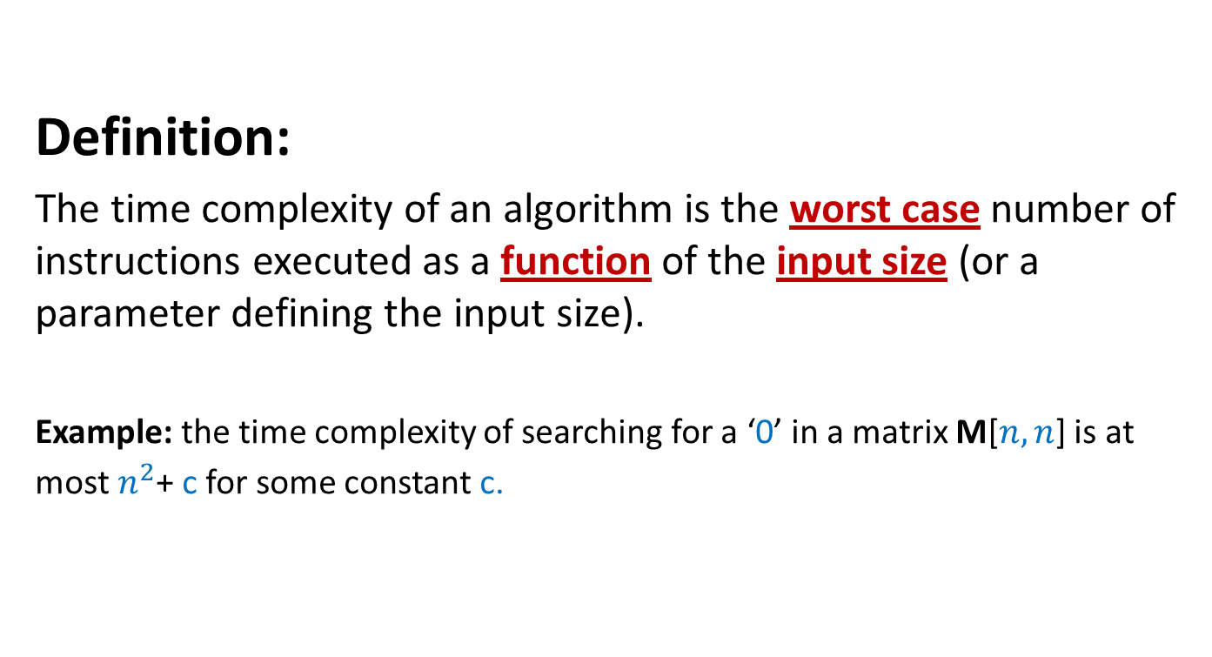
Time complexity of an algorithm
Definition:
The time complexity of an algorithm is the worst case number of instructions executed as a function of the input size (or a parameter defining the input size).
Example: the time complexity of searching for a ‘0’ in a matrix M[$n,n$] is at most $n^{2}$+ c for some constant c.

Slide 3

Example: Time complexity of matrix multiplication
Matrix-mult(C[n,n],D[n,n])
{ for i = 0 to n-1
{ for j=0 to n-1
{ M[i,j] = 0;
for k=0 to n-1
{ M[i,j]= M[i,j] + C[i,k]*D[k,j];
}
}
}
Return M
}
Time complexity = $n^{3}+n^{2}+1$

Slide 4
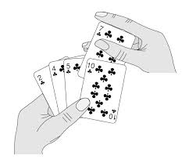
Insertion Sort
A simple sorting algorithm.
Popular to sort a hand of cards.
Start with the cards face down and empty left hand.
Pick a card with the right hand and insert it into the correct position in the left hand.

Slide 5
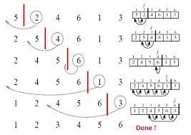
Insertion Sort
Given an array A[1…n] of numbers.
Objective is to place the numbers in sorted (non-decreasing) order in the array.
InsertionSort(A,n) {
for j = 2 to n {
key = A[j]
i = j-1
while (i > 0) && (key < A[i]){
A[i+1] = A[i]
A[i] = key
i=i-1
}
}
An illustration

Slide 6
Algorithms
We generally do two things with an algorithm.
Prove its correctness. That is, show that it achieves the objective for which it was designed.
Analyze its running time.
(If relevant, we also analyze the space usage. For insertion sort, space usage is A[1..n] plus a few variables: not relevant).
What does running time mean? Discussion in a few slides.

Slide 7
Loop-invariant
How did we design insertion-sort?
In each iteration j, A[j] is placed in its sorted position in A[1..j-1].
Loop invariant:
At the beginning of the for loop in lines 1—8, the subarray A[1…j-1] is sorted.
InsertionSort(A,n) {
1. for j = 2 to n {
2. key = A[j]
3. i = j-1
4. while (i > 0) && (key <A[i]){
5. A[i+1] = A[i]
6. A[i] = key
7. i=i-1
8. }
9. }
Two points regarding loop invariants:
Does it help prove the correctness?
How do we establish the invariant?
For insertion sort:
upon termination j equals n+1.
Hence by invariant: A[1..n] is sorted.

Slide 8
Establishing the invariant
InsertionSort(A,n) {
1. for j = 2 to n {
2. key = A[j]
3. i = j-1
4. while (i > 0) && (key < A[i]){
5. A[i+1] = A[i]
6. A[i] = key
7. i=i-1
8. }
9. }
Usually invariants are proved using induction.
Base case: j = 2 and A[1..1] is sorted. Correct.
Assume at the beginning of for loop that A[1..j-1] is sorted.
Now show that A[j] is placed in its correct position and elements larger than A[j] are shifted to the right by 1.
Thus A[1…j] is sorted.
Invariant
At the beginning of the for loop in lines 1—8, the subarray A[1…j-1] is sorted.

Slide 9
Loop invariants (contd).
InsertionSort(A,n) {
1. for j = 2 to n {
2. key = A[j]
3. i = j-1
4. while (i > 0) && (key < A[i]){
5. A[i+1] = A[i]
6. A[i] = key
7. i=i-1
8. }
8. }
Invariants can (and perhaps should) be designed for all loops.
Inner (while) loop invariant:
At the beginning of the while loop of lines 4—7,
A[1..i] is sorted, A[i+1..j] is sorted and key = A[i+1] and A[1..i, i+2..j] is the original sub-arry and is sorted.
Invariant
At the beginning of the for loop in lines 1—8, the subarray A[1…j-1] is sorted.
Problem: 1. Show by induction that the inner loop invariant holds.
2. Upon termination of inner loop A[1..j] is sorted.

Slide 10


Analyzing insertion-sort
Let us analyze the running time of insertion sort.
But first, what does running time mean?
On a given input array A[1…n], count the number of instructions executed while running the algorithm (after converting to code).
Doesn’t it depend on how the algorithm is compiled?
Assignments, boolean comparisons, access to array elements may have different costs.

Slide 11
The Random Access Memory Machine Model
So let us define an abstraction of a computer.
If you open a computer, there are many devices, the processor, memory, cards for network, video, wi-fi, disk and system bus.
For sake of algorithm analysis, we will consider a much simpler model, called
the Random Access Memory or RAM model.
A schematic description of the RAM abstract machine
CPU
0x0
MEMORY
0xFFFF…

Slide 12
RAM model
A schematic description of the RAM abstract machine
CPU
12
0x0
Random Access MEMORY (RAM)
0xFFFF…
There is one CPU and a very large amount of memory.
RAM is divided into addressable units called words. In practice, a word is typically 32 bits, 64 bits, etc.
Access to the RAM is assumed uniform: any word can be accessed in unit time.
Program resides in memory and is fetched into CPU.
Execution of simple operations, e.g., integer, boolean, floating point, logical operations, comparisons are done in unit time.
But there is now a difference between calculations made on the RAM model and an actual computer.

Slide 13
There is a difference between the calculations done for the RAM model and the actual time taken on the computer
.
But we will calculate time taken by algorithms in the Order notation, which in summary, keeps the asymptotic dominant term only.
For example, if the calculation of time on the RAM model is 3n^2 + 5n + 1, we will refer to this as O(n² ). More on this in a few slides.

Slide 14
Worst case analysis
InsertionSort(A,n) {
1. for j = 2 to n {
2. key = A[j]
3. i = j-1
4. while (i > 0) && (key < A[i]){
5. A[i+1] = A[i]
6. A[i] = key
7. i=i-1
8. }
9. }
Among all inputs of size n, we obtain an upper bound on the maximum or worst-case time taken by an input instance for that problem.
For insertion-sort, the worst-case occurs when the array A is sorted in descending (non-ascending) order.
Let us calculate the worst-case time requirement.
7
6
5
4
3
2
1
Worst case for insertion-sort

Slide 15
Time complexity of an algorithm
Definition:
The time complexity of an algorithm is the worst case number of instructions executed as a function of the input size (or a parameter defining the input size).
Example: the time complexity of searching for a ‘0’ in a matrix M[$n,n$] is at most $n^{2}$+ c for some constant c.

Slide 16

2
To calculate worst-case time:
Identify worst-case(s)
Calculate number of instructions in inner-most loops for worst-case(s).
InsertionSort(A,n) {
1. for j = 2 to n {
2. key = A[j]
3. i = j-1
4. while (i > 0) && (key < A[i]){
5. A[i+1] = A[i]
6. A[i] = key
7. i=i-1
8. }
9. }
Lines 5-8 is executed how many times?
j-1 times
for each value of j fixed in line 1.
Total number of times each of the lines 5-8 are executed is:
7
6
5
4
3
2
1
Worst case for insertion-sort
Line 4 is executed j times for each value of j in line 1.
Total : n(n+1)/2.
Number of operations per execution is 3 ( i>0, key < A[i] and &&)
Lines 2-3 are executed n-1 times each: total cost = 2(n-1)
Line 1 cost: 1 + 2(n-1) = 2n-1
Total: 3n(n-1)/2 + 3n(n+1)/2 + 2n-1 + 2(n-1) = 3n² + 4n -3

Slide 17
Asymptotic Time Complexity
InsertionSort(A,n) {
1. for j = 2 to n {
2. key = A[j]
3. i = j-1
4. while (i > 0) && (key < A[i]){
5. A[i+1] = A[i]
6. A[i] = key
7. i=i-1
8. }
9. }
Time-complexity function of an algorithm is mentioned in terms of the asymptotically dominant term.
Thus, insertion-sort is referred to as O(n² ) algorithm.
Why?
The worst-case time complexity function grows as c·n² asymptotically.
Precise constants change with the machine. Asymptotic growth rate does not change.

Slide 18
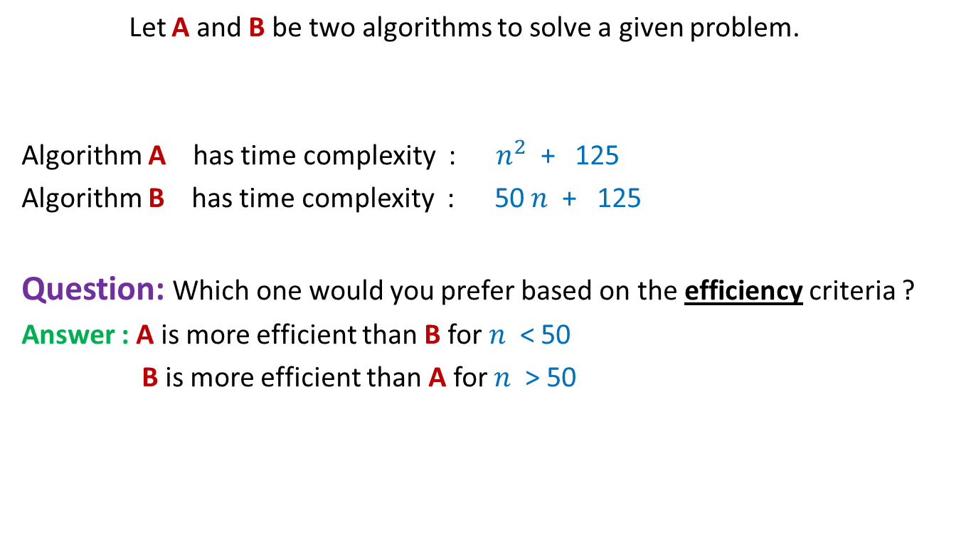
Comparing efficiency of two algorithms
Let A and B be two algorithms to solve a given problem.
Algorithm A has time complexity : $n^{2}$ + 125
Algorithm B has time complexity : 50 $n$ + 125
Question: Which one would you prefer based on the efficiency criteria ?
Answer : A is more efficient than B for $n$ < 50
B is more efficient than A for $n$ > 50
Time complexity is really an issue only when the input is of large size
Asymptotically, Algorithm B is more efficient

Slide 19
Asymptotic Time Complexity
We compare the time complexities of two algorithms for asymptotically large value of input size only,
that is, as n -> ∞
Only the most dominant term is important

Slide 20
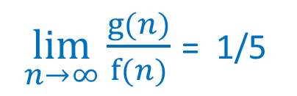

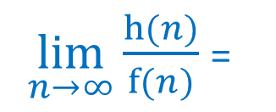
Example 1:
Algorithm A for a given problem has time complexity f($n$)= ${5 n}^{2}$ + $n$+ 1250
Researchers have designed two new algorithms B and C
Algorithm B has time complexity g($n$) = $n^{2}$ + 10
Algorithm C has time complexity h($n$) = ${10 n}^{1.5}$ + 20 $n$ + 2000
Which of B and C is an improvement over A asymptotically?
$\lim_{n→∞}{\frac{g(n)}{f(n)}}$ = 1/5
$\lim_{n→∞}{\frac{h(n)}{f(n)}}$ =
0
C is an improvement over A asymptotically.

Slide 21
Another Rule
An algorithm X is superior to another algorithm Y
if
the ratio of time complexity of X and time complexity of Y approaches 0 asymptotically.

Slide 22
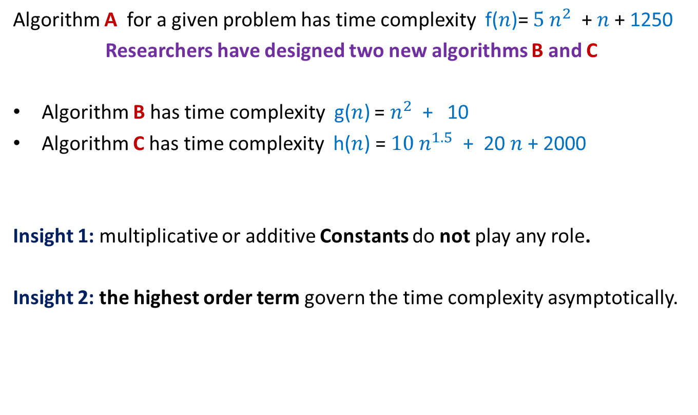
Some insights from the Exercise 1
Algorithm A for a given problem has time complexity f($n$)= ${5 n}^{2}$ + $n$+ 1250
Researchers have designed two new algorithms B and C
Algorithm B has time complexity g($n$) = $n^{2}$ + 10
Algorithm C has time complexity h($n$) = ${10 n}^{1.5}$ + 20 $n$ + 2000
Insight 1: multiplicative or additive Constants do not play any role.
Insight 2: the highest order term govern the time complexity asymptotically.

Slide 23
Order Notations : a neat and Precise description of Asymptotic Time Complexity

Slide 24


Order notation O()
Definition: Let f(n) and g(n) be any two increasing functions of n. f(n) is said to be of the order of g(n) if there exist constants c and $n_{0}$such that
f(n) ≤ c g(n) for all n > $n_{0}$
c g(n)
f(n)
$$n_{0}$$
If f(n) is of the order of g(n), we write f(n) = O(g(n))

Slide 25
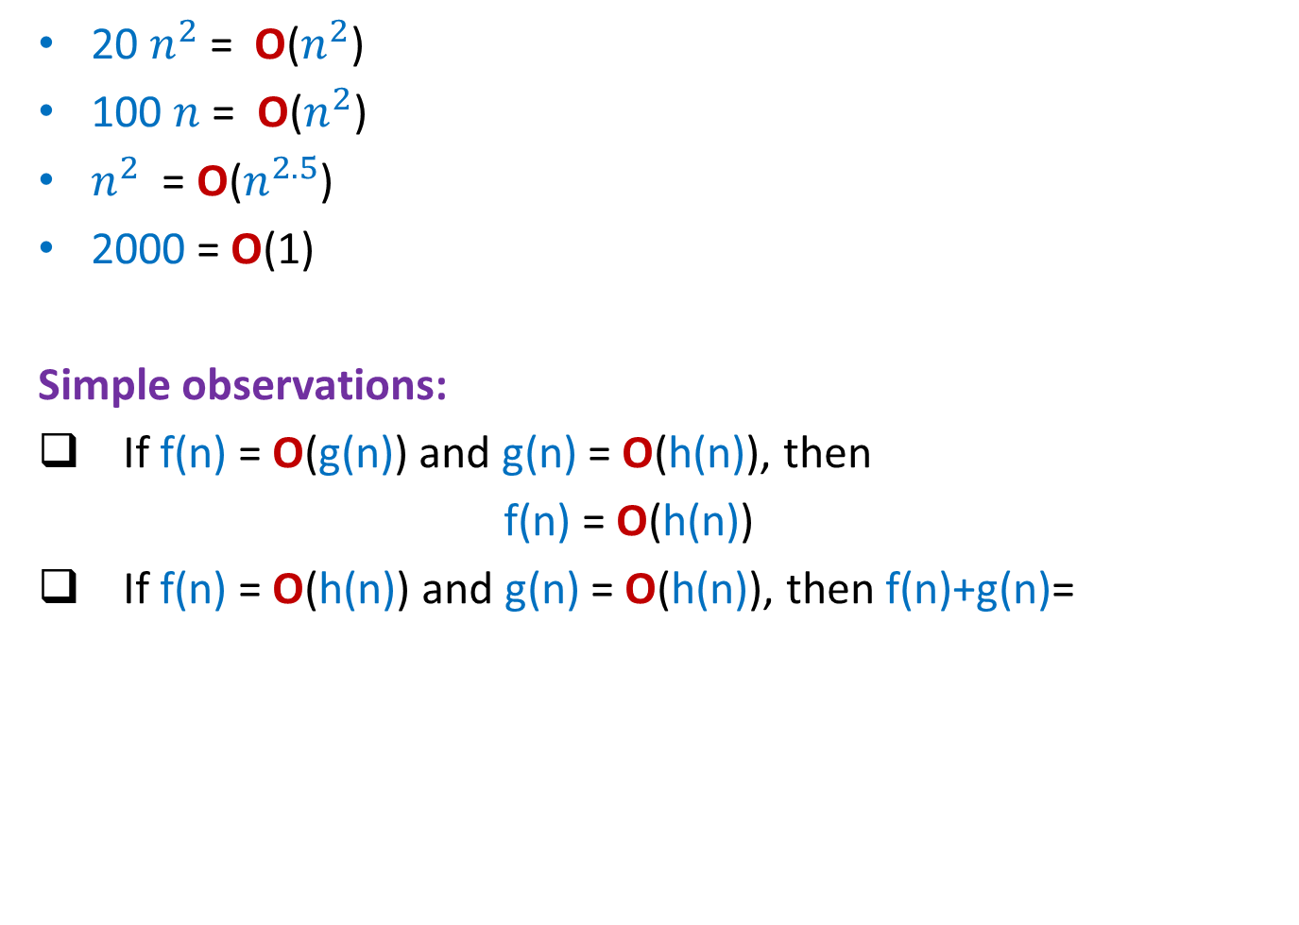
Order notation O()
20 $n^{2}$ = O($n^{2}$)
100 $n$ = O($n^{2}$)
$n^{2}$ = O($n^{2.5}$)
2000 = O(1)
Simple observations:
If f(n) = O(g(n)) and g(n) = O(h(n)), then
f(n) = O(h(n))
If f(n) = O(h(n)) and g(n) = O(h(n)), then f(n)+g(n)=
O(h(n))

Slide 26
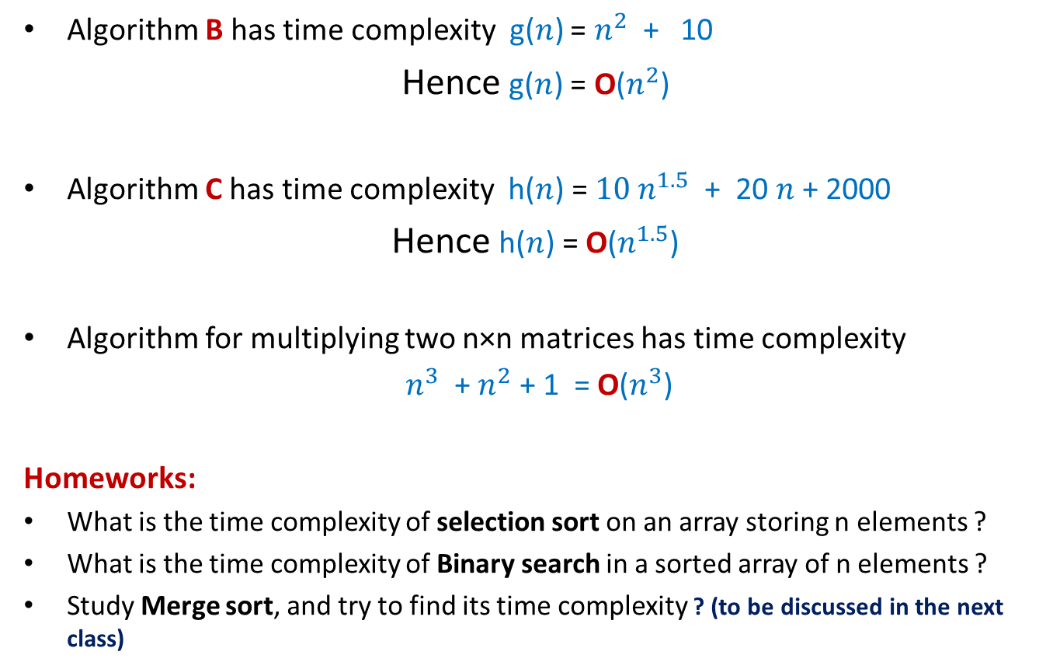
Order O() notation
Algorithm B has time complexity g($n$) = $n^{2}$ + 10
Hence g($n$) = O($n^{2}$)
Algorithm C has time complexity h($n$) = ${10 n}^{1.5}$ + 20 $n$ + 2000
Hence h($n$) = O($n^{1.5}$)
Algorithm for multiplying two n×n matrices has time complexity
$n^{3}$ + $n^{2}$ + 1 = O($n^{3}$)
Homeworks:
What is the time complexity of selection sort on an array storing n elements ?
What is the time complexity of Binary search in a sorted array of n elements ?
Study Merge sort, and try to find its time complexity ? (to be discussed in the next class)

Slide 27
Lower bounds Ω() notation
A function f(n) is said to be Ω(g(n))
if f(n) >= c· g(n),
asymptotically.
That is, there exists some n₀ such that for n >= n₀ ,
f(n) >= c · g(n)
for some positive constant c.
f(n)
f(n) = Ω(g(n))
c·g(n)
n₀
n

Slide 28
Ω() and O()
f(n) is Ω(g(n)) implies that g(n) = O(f(n)).
Vice-versa, f(n) is O(g(n)) implies g(n) = Ω(f(n)).
Read as follows:
f(n) = O(g(n)) read as f is upper bounded by g asymptotically.
f(n) = Ω(n) read as f is lower bounded by g asymptotically.
For order notations, we will assume that f and g are non-negative functions on the range n >= 0.

Slide 29
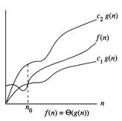
Theta Θ Notation
f(n) is said to be Θ(g(n)) if
f(n) = O(g(n)) and
f(n) = Ω(g(n))
In other words, f is upper bounded by c₁·g asymptotically and f is lower bounded by c₂·g.
Formally, there exist positive real constants c₁, c₂ and n₀ such that for all n > n₀,
c₁ ·g(n) <= f(n) <= c₂·g(n),
f(n) = Θ(g(n))

Slide 30
Simple properties of Θ() notation
Read f(n) = Θ(g(n)) as f(n) is of the same order as g(n) asymptotically.
Symmetry: f(n) = Θ(g(n)) iff g(n) = Θ(f(n)).
Transitivity: f(n) = Θ(g(n)) and g(n) = Θ(h(n)) implies f(n) = Θ(h(n)).
Reflexivity is obvious: f(n) = Θ(f(n)).
So, if we define a relation R such that
f R g if f(n) = Θ(g(n)),
then R is an equivalence relation.
Implying that if f(n) = Θ(g(n)) and f(n) ≠ Θ(h(n))
then g(n) ≠ Θ(h(n))

Slide 31
Simple properties of Θ() contd.
If f(n) = Θ(g(n)) and h(n) = Θ(k(n)) then
f(n) + h(n)= Θ(g(n) + k(n)), and
f(n)· h(n)= Θ(g(n)·k(n)), so on.

Slide 32
Some examples
n = Θ(n)
n = O(n log n)
n = O(n² ), n = O(n³ ), …
n log(n) = O(n log (n) (log(log(n))))
2^{n} = O(2^{n-1})
2^{n} = Ω(2^{n/2})
2^{n} = Θ(2^{n-1})
f(n) = Θ(g(n)) iff f(n) = O(g(n)) and g(n) = O(f(n))

Slide 33
Example Problem

Slide 34
Max-sum subarray problem: Designing efficient algorithm
Given an array A storing n numbers, find its subarray the sum of whose elements is maximum?
4
7
A
3 -5 3 8 2 -4 9 -6 3 -2 -8 3 -5 1 7 -9
18
-2

Slide 35
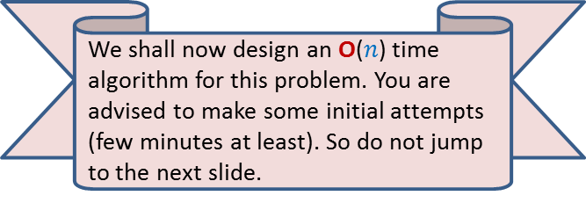

Max-sum subarray problem: A trivial algorithm
A_trivial_algo(A)
{ max= A[0];
for i=0 to n-1
for j=i to n-1
{ temp = compute_sum(A,i,j);
if max< temp then max= temp;
}
return max;
}
compute_sum(A, i,j)
{ sum=A[i];
for k=i+1 to j
sum= sum+A[k];
return sum;
}
Homework: Prove that its time complexity is O($n^{3}$)
We shall now design an O($n$) time algorithm for this problem. You are advised to make some initial attempts (few minutes at least). So do not jump to the next slide.

Slide 36
Max-sum subarray problem: Designing efficient algorithms
Facts from the world of algorithms:
Designing an efficient algorithm or data structure requires
An insight into the existing efficient algorithms for various problems and the ability to use that insight at right place.
Ability to make key observation about the problem and its solution.
May take time, so please persevere.

Slide 37
Max-sum subarray problem: Towards designing an O(n) time algorithm
Let S(i): the sum of the largest-sum subarray ending at A[i].
Note that A[i] surely contributes to S(i) (empty subarrays are not considered).
i=5
A
3 -5 3 8 2 -4 8 -6 3 -2 -8 3 -5 1 7 -9
-4
-2
6
9
S(i)=9 for i = 5
4
7

Slide 38
Max-sum subarray problem: Towards designing an O(n) time algorithm
Observations:
In order to solve our problem, it suffices to compute S(i) for all possible 0 ≤ i ≤ n-1.
Since our objective is to achieve O(n) time complexity bound, we need a way to compute S(i) in O(1) time only. How can we achieve this goal ?
Lesson you should have learnt from the iterative algo for Fibonacci number
Solve a problem incrementally.
How to use the above insight from Fibonacci number ?
Question: what is the relation between S(i) and S(i-1) ?

Slide 39
Max-sum subarray problem: Towards designing an O(n) time algorithm
If S(i-1) ≤ 0 then
S(i)=A[i]
If S(i-1) > 0 then
S(i) = S(i-1) + A[i]
Homework:
Prove the above mentioned relation between S(i) and S(i-1).
Design an O(n) time algorithm for Max-sum subarray using the above formulation.

